Slide 1
module 4 final project
ASAD RAHMAN

Slide 2
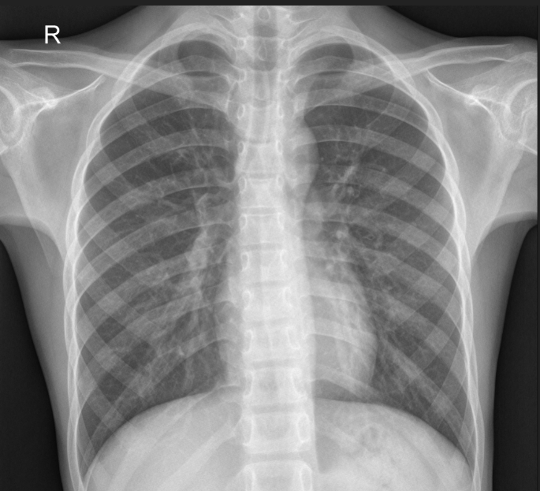
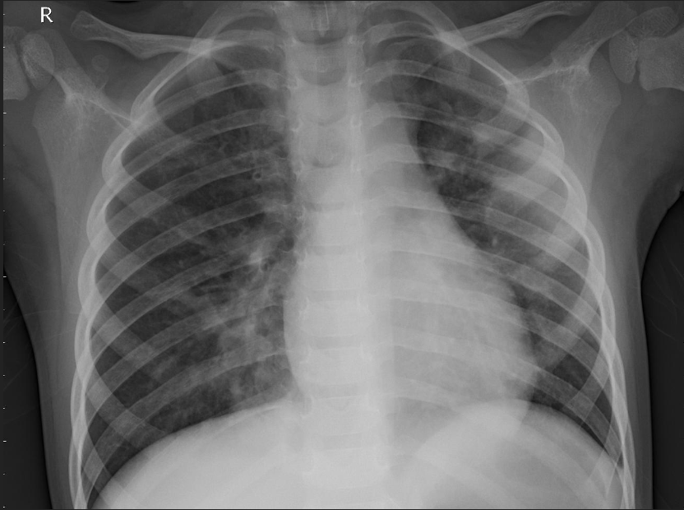
PROJECT AIMS
Increase efficiency in Pneumonia detection in X-rays

Slide 3

METHODOLOGY
DATASET: 5,863 X-Rays
CREATE and TEST MODEL
IMPROVE MODEL with OPTIMIZATION

Slide 4
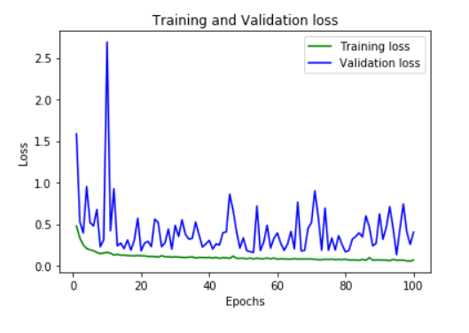
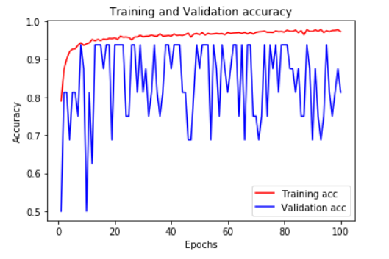
BASELINE MODEL
Base Keras model obtained 98% accuracy on training images
Only 74% accuracy on testing images

Slide 5
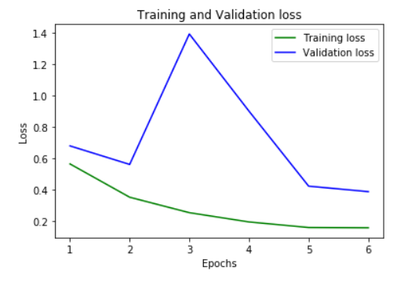
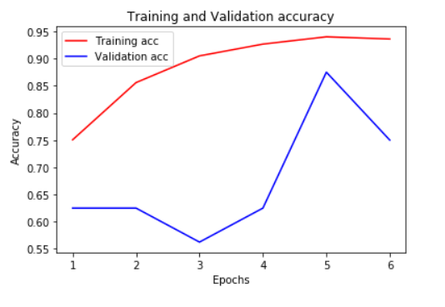
Convolutional Neural Network
Training image accuracy 90%
Testing image accuracy 80%

Slide 6
Future Recommendations
Optimize Neural Network
Increase testing time
Increase testing data sest

Slide 7

Thank You

